Slide 1
Natural language processing
Lecture 9: Language Generation II
Roberta Rocca
Assistant Professor, IMC & CHC
✉️ roberta.rocca@cas.au.dk
Notes:
TODO:
Why does repetition happen?
Fix slide 16

Slide 2
Exercise
What is decoding in a language model – and how does it relate to the difference between language modeling and language generation? How can decoding be performed? What are the pros and cons of each approach?
You want to perform a sequence classification task (with text as input): based on what we have seen so far, list three architectures which you *can* use perform this task end-to-end, and try to highlight pros and cons of each
Notes:
Mention key, query, value

Slide 3
Recap: from language modeling to language generation
Transformer models can perform autoregressive / forward / causal language modeling through (masked) self-attention
This provides us with predicted probability distributions for the next token in a sequence, computed from contextualized representations of the last token
At inference, these probability distributions can be used to generate the next word
The process through which we generate the next word from a probability distribution is called decoding
There are multiple (deterministic and probabilistic) approaches to sampling, which differ in the characteristics (e.g., creativity, but also potential for disfluencies) of output text
Notes:
Both intelligence

Slide 4
Recap: language generation as a universal paradigm
Next token prediction using cross-entropy loss and teacher forcing can be used to training models for any natural language generation task
But the beauty of NLG is that we can do more than that: by adapting the input the model receives (prompt), we can get models to perform virtually any task, even non-NLG tasks (e.g., classification)
This is the strong intuition behind T5: training a model with task-specific instructions turns a generic NLG model into a good task-specific model!
Can we do even more than that, following the intuition that everything is NLG?
Notes:
Both intelligence

Slide 5
Today’s plan
The text-to-text paradigm and instruction fine-tuning: T5
Learning without fine-tuning (zero-shot generalization and in-context learning): GPT-3
Large-scale instruction fine-tuning for zero-shot generalization: FLAN
Aligning models with human preferences (RLHF)
Notes:
Both intelligence

Slide 6
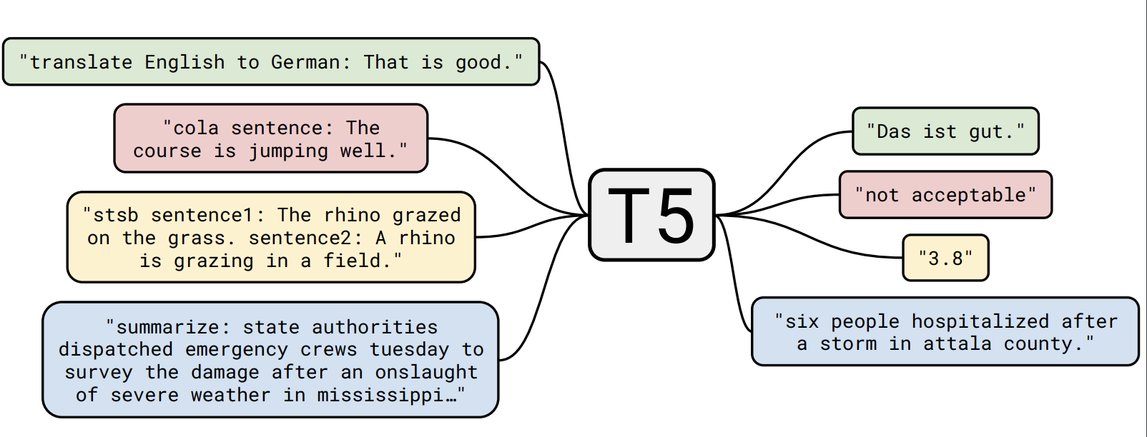
Text-to-text as a universal paradigm
All tasks can be reduced to text-to-text tasks: generating an output sequence based on an input sequence
For example: for summarization, you can prepend a short task description to the input, which instructs the model about “what to do” with the input
Models can be trained on this instruction + input + completion data, like regular LMs
Notes:
Working definition so far

Slide 7
Text-to-text transfer transformer (T5)
A unified architecture, treating all tasks as text-to-text tasks (Raffel et al., 2019)
Notes:
Working definition so far

Slide 8
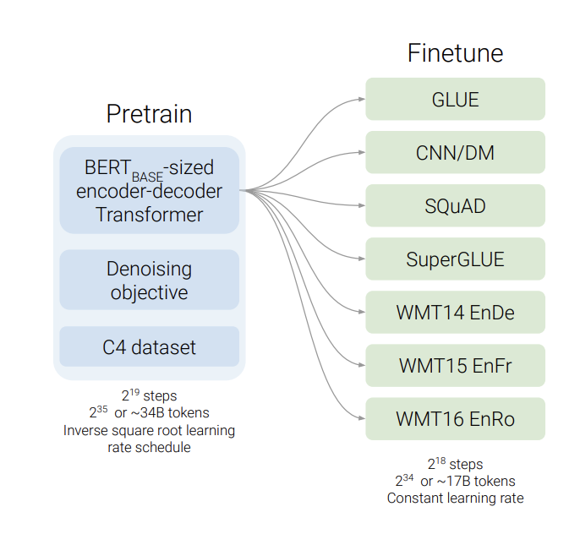
T5’s approach
Pretrain a model on a version of masked language modeling using a huge corpus (C5)
Fine-tune models individually on each of the tasks, using this “text-to-text” approach, where prompts/instructions are appended to the input (meta-learning, instruction-tuning)
Models learn to follow task instructions, which yields good performance
Notes:
Working definition so far

Slide 9
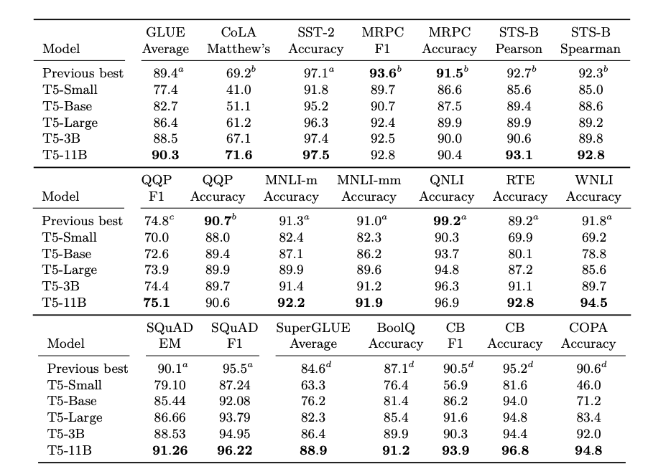
T5’s approach
Notes:
Working definition so far

Slide 10
Why this is mindblowing
You can use the same architecture for any possible task: all you need to change is the prompt
But this can be pushed even further
You can in theory train the same model on multiple tasks at the same time (multitask learning)...
If text-to-text models develop these “meta-learning” skills, i.e., they learn to interpret instructions, they may, in principle, understand instructions for new tasks they have never seen before, without the need for additional training…
Notes:
Working definition so far

Slide 11
Learning without fine-tuning
T5 still assumes that, to perform a task, the model needs to be explicitly fine-tuned on input-output pairs related to that task
This transfer learning paradigm is a common one, but what if we could push this one step further?
What if a model could perform a new task without having been explicitly trained on that task? Is language the key to flexible machine intelligence?
Notes:
Working definition so far

Slide 12
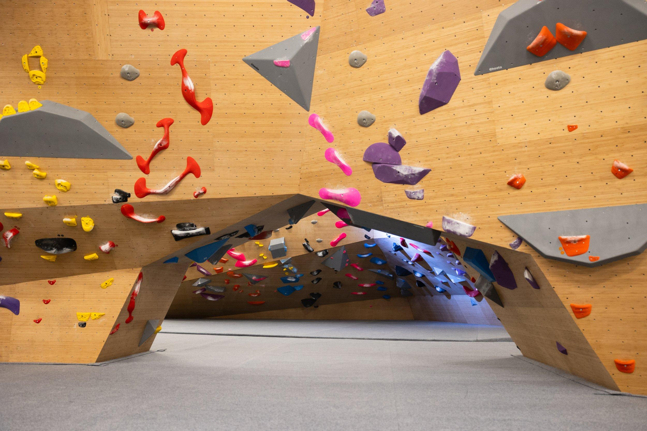
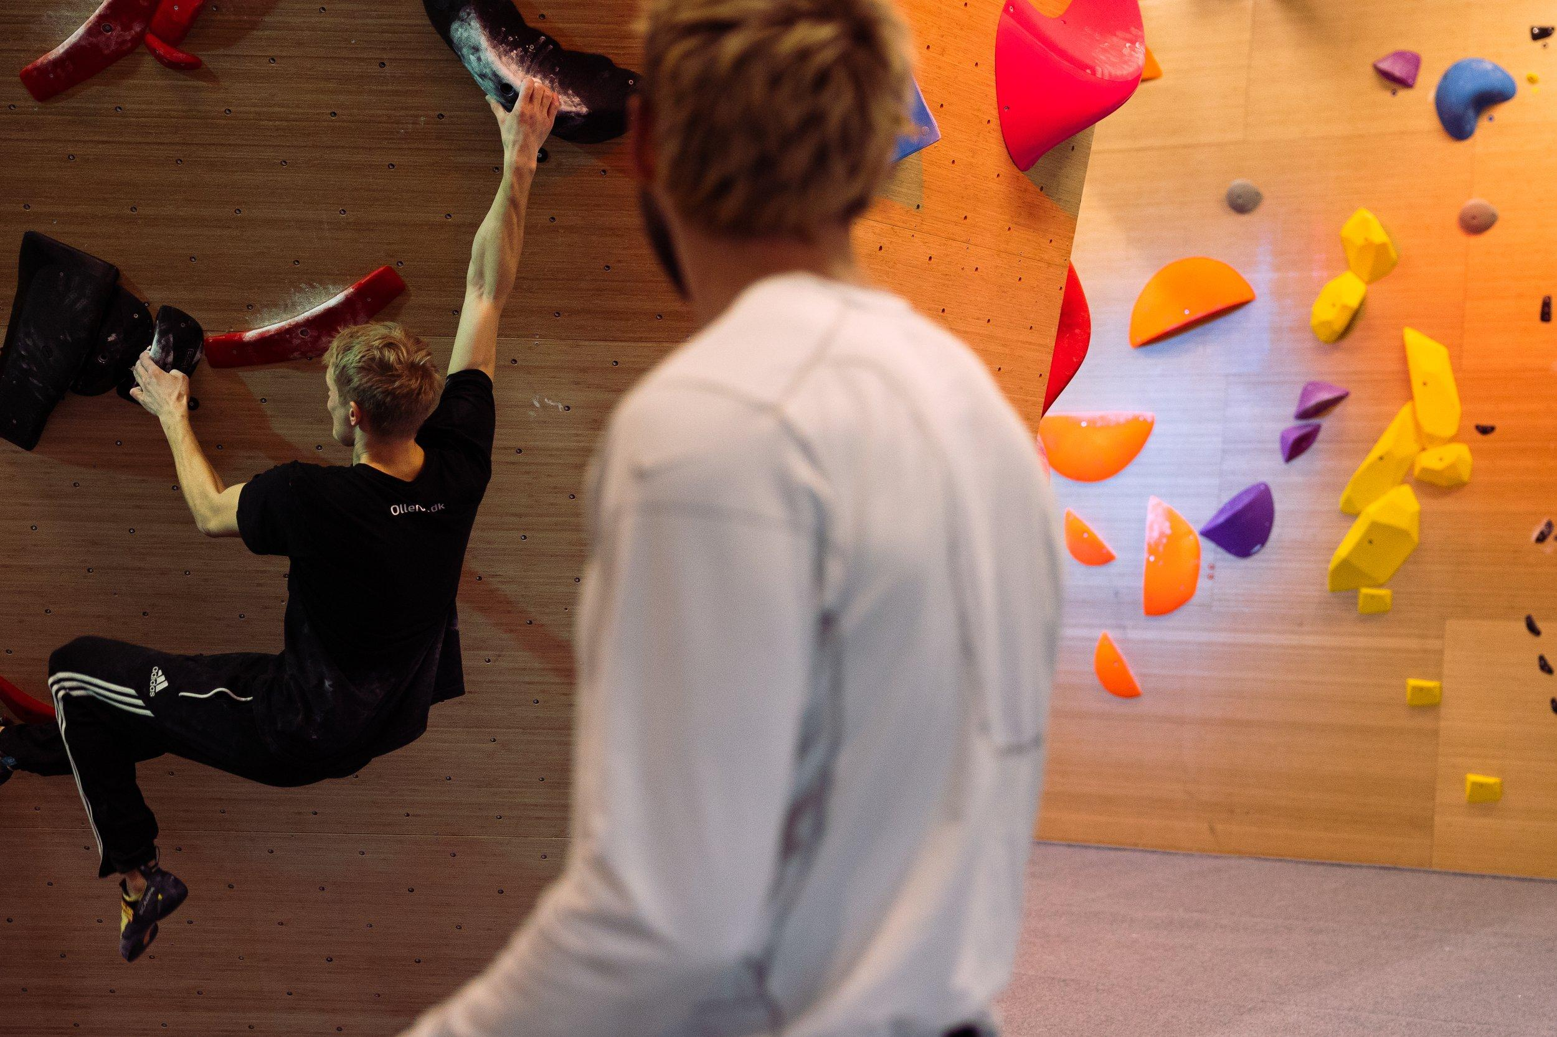
Humans do it all the time
we can transfer more general knowledge from other domains
we can learn by imitation
Notes:
Working definition so far

Slide 13
Few-shot learning: model is passed an input which contains a task description, and a few examples
Learning without fine-tuning/training
Input:
“Sentence: the movie was great. Sentiment: Positive.
Sentence: this restaurant is dark and gloomy.
Sentiment: Negative
Sentence: I love pizza.
Sentiment: ”
We have a task the model has never seen before, e.g, sentiment classification
Notes:
Working definition so far

Slide 14
One-shot learning: model is passed an input which contains a task description, and one example
Learning without fine-tuning/training
Input:
“Sentence: the movie was great. Sentiment: Positive.
Sentence: I love pizza.
Sentiment: ”
We have a task the model has never seen before, e.g, sentiment classification
Notes:
Working definition so far

Slide 15
Zero-shot generalization: model is passed an input with a task description, but no example
Learning without fine-tuning/training
Input:
“Sentence: I love pizza.
Sentiment: ”
We have a task the model has never seen before, e.g, sentiment classification
Notes:
Working definition so far

Slide 16
Often called “in-context” learning for one- or few-shot contexts
Learning without fine-tuning/training
We have a task the model has never seen before, e.g, sentiment classification
Notes:
Working definition so far

Slide 17
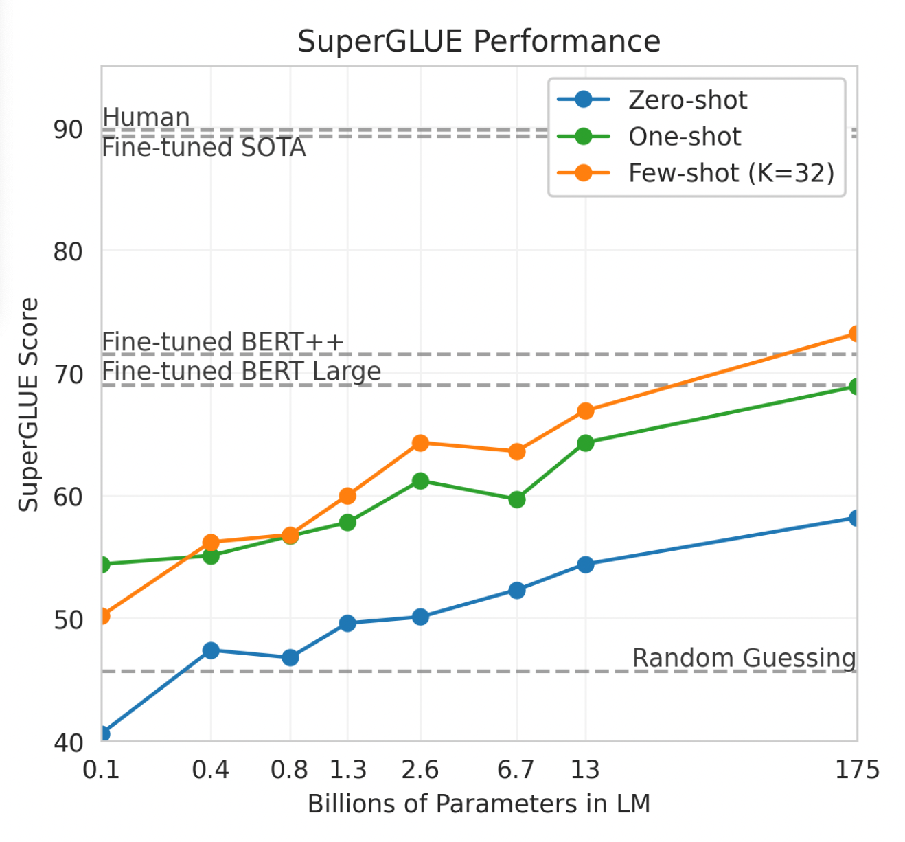
GPT-3: language models are few-shot learners
T5 focuses explores the potential of text-to-text approaches to NLG in the context of a transfer learning paradigm
The GPT-3 tests a different approach to NLG: what if language modeling training at scale was enough to achieve good performance on many NLG tasks?
What if task-specific fine-tuning was not needed at all? What if all we needed was good prompt engineering?
Notes:
Working definition so far

Slide 18
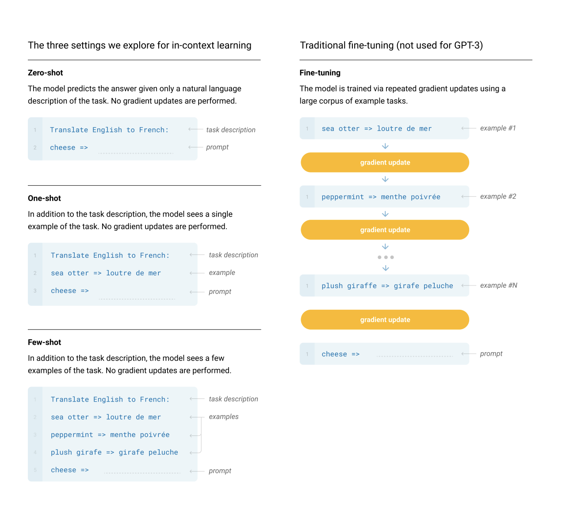

Slide 19
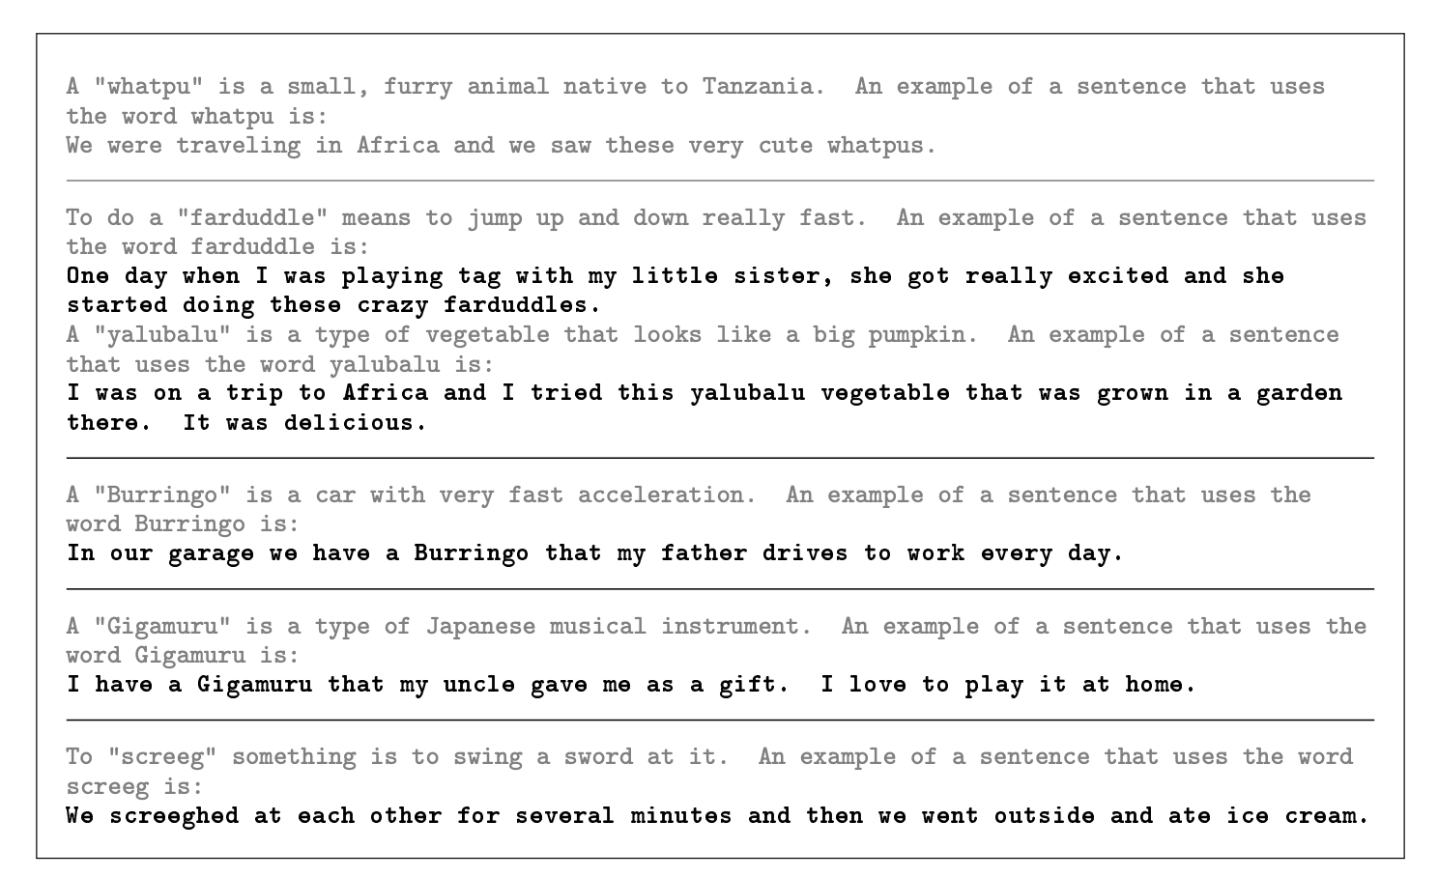

Slide 20
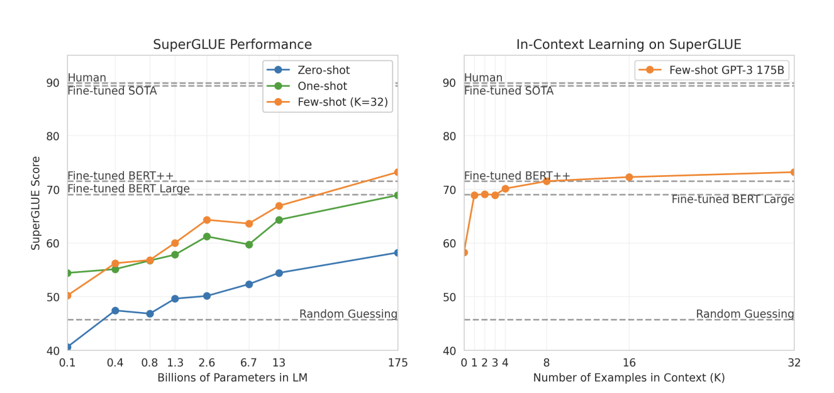
GPT-3: some results
Excellent few-shot performance, while zero-shot performance still lags behind…

Slide 21
FLAN: instruction-tuning for zero-shot generalization
Zero-shot generalization is really the Holy Grail of NLG: can we combine what we have learned from T5 and GPT-3 to achieve that?
With FLAN, we try a new approach: training on many tasks at once. For each task, we create instructions which turns the task into text-to-text
With sufficient training models could learn a meta-skill, that of following instructions
Hence: they will generalize to tasks/instructions they have never seen, achieving zero-shot generalization
Pretrained Model
Fine-tune on tasks clusters A, B, C
Evaluate (zero-shot) on task cluster D
Notes:
Working definition so far

Slide 22
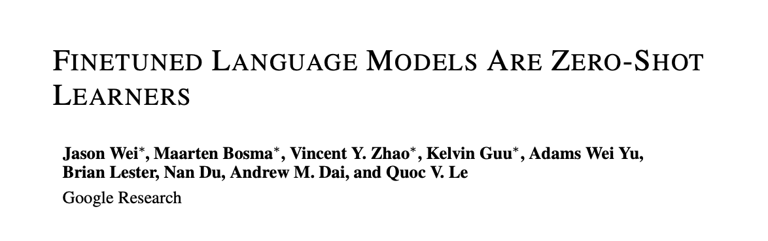
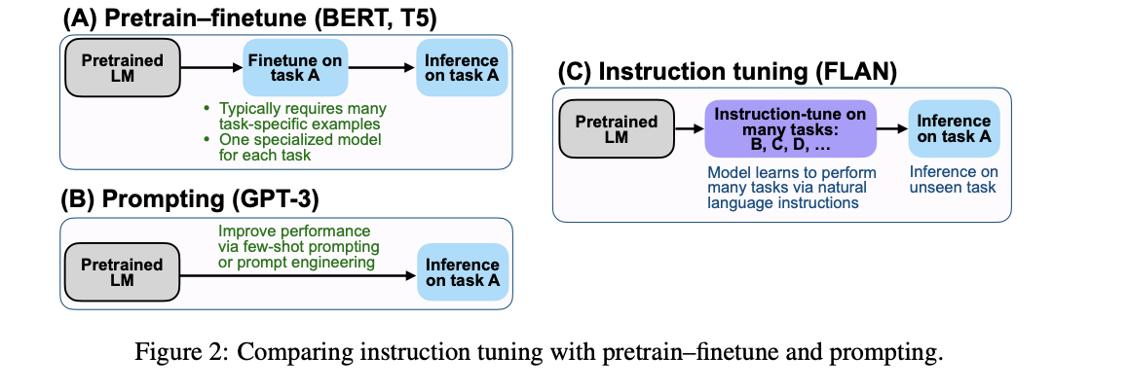
FLAN: instruction fine-tuning for zero-shot generalization
(Wei et al., 2022)
Notes:
Working definition so far

Slide 23
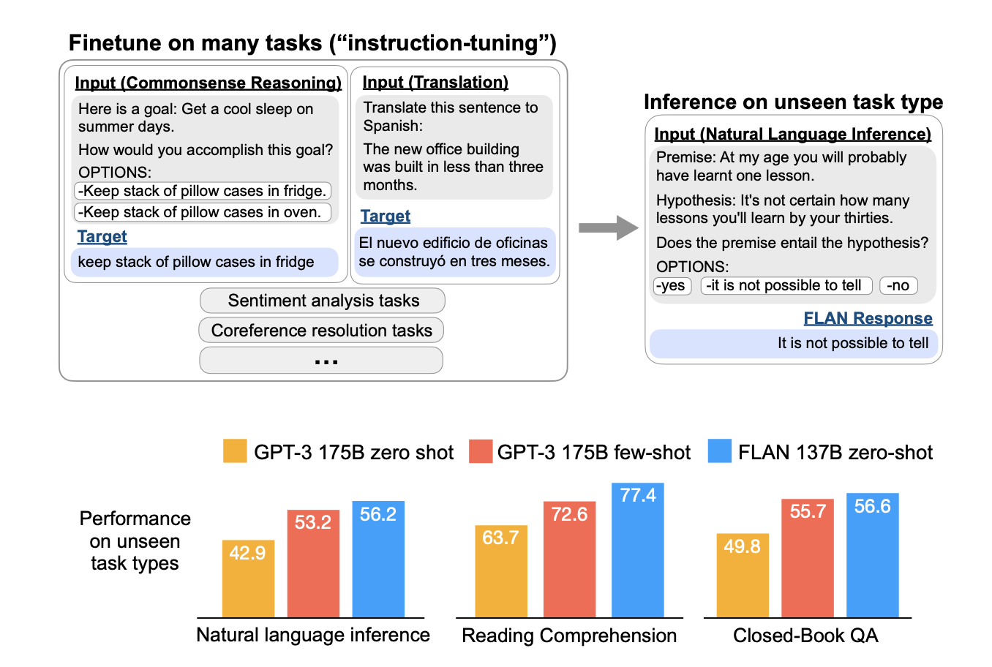
Notes:
Working definition so far

Slide 24
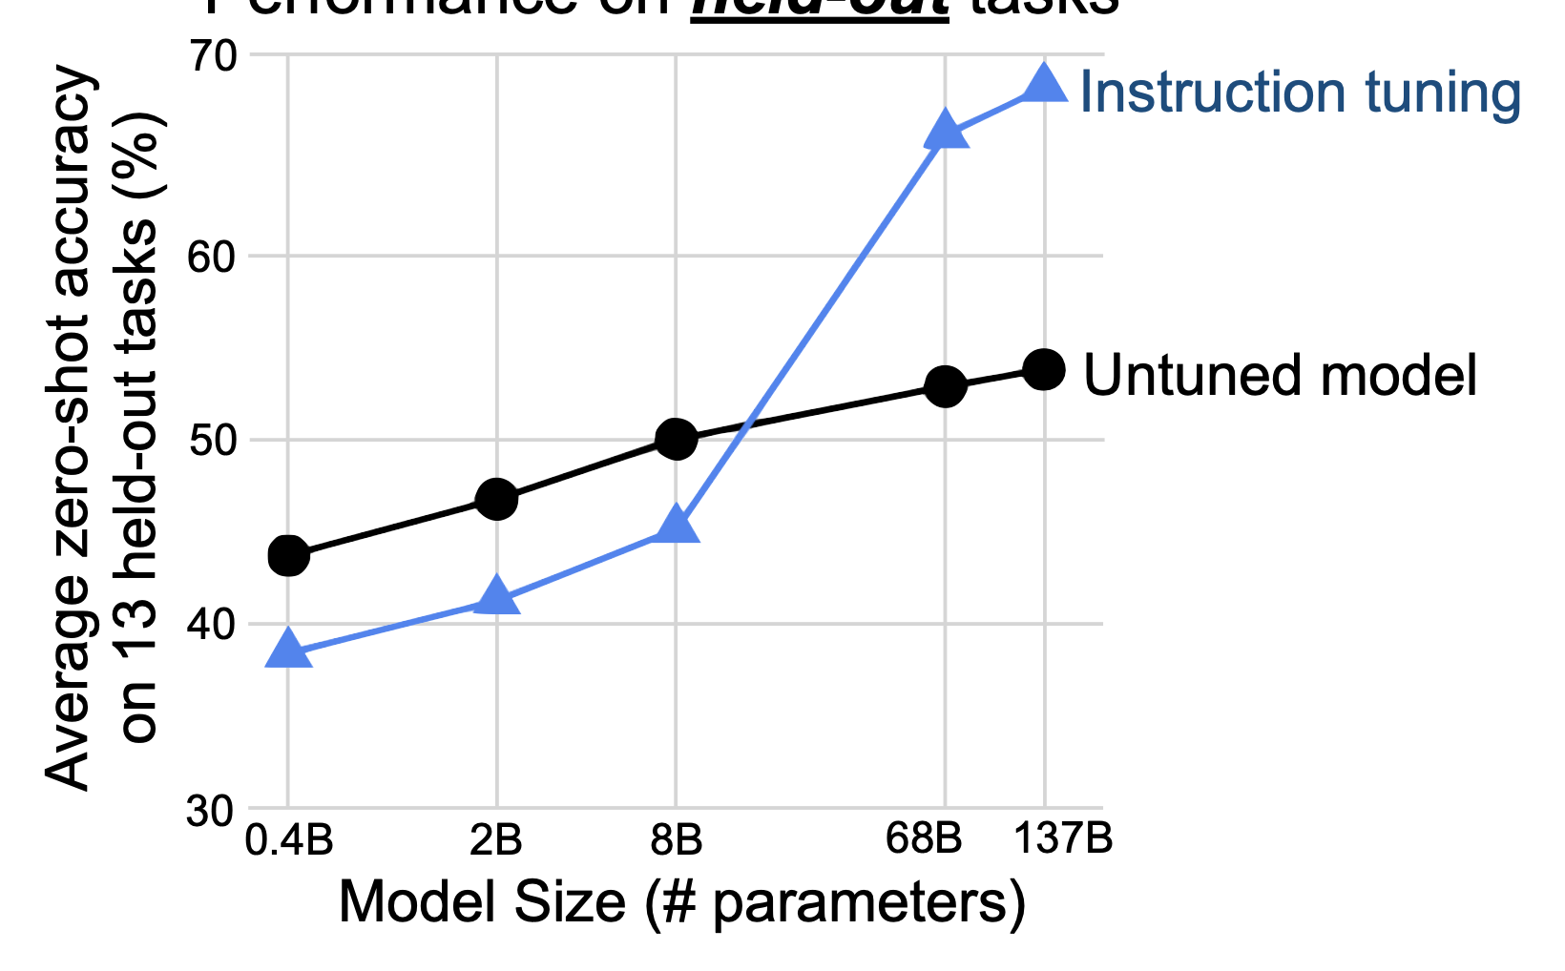
Combining fine-tuning and prompting (FLAN)
On many tasks, FLAN models achieve good zero-shot performance
Note, however, that (like in-context learning capabilities) this is highly dependent on model scale
It can also be combined with other techniques (e.g., prompt tuning)
Notes:
Working definition so far

Slide 25
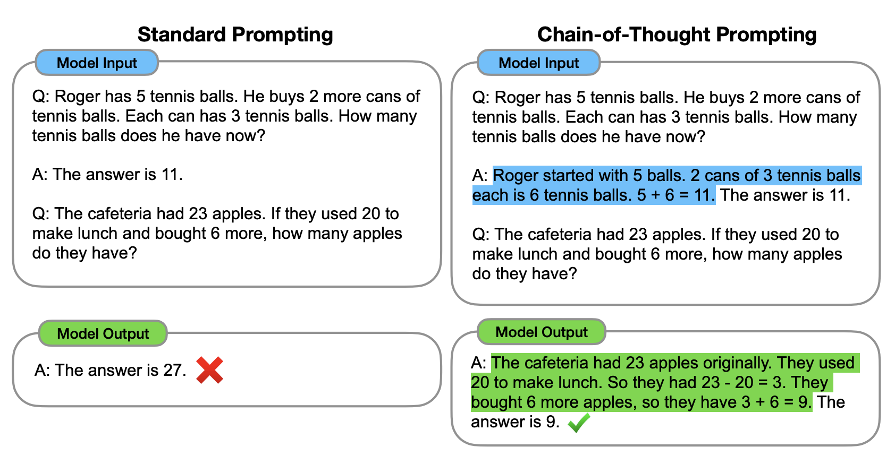
Chain-of-thought prompting
Also used in PaLM: see Chowdhery et al., 2022, https://arxiv.org/abs/2204.02311
Wei et al., 2022: https://arxiv.org/pdf/2201.11903.pdf
Notes:
Working definition so far

Slide 26
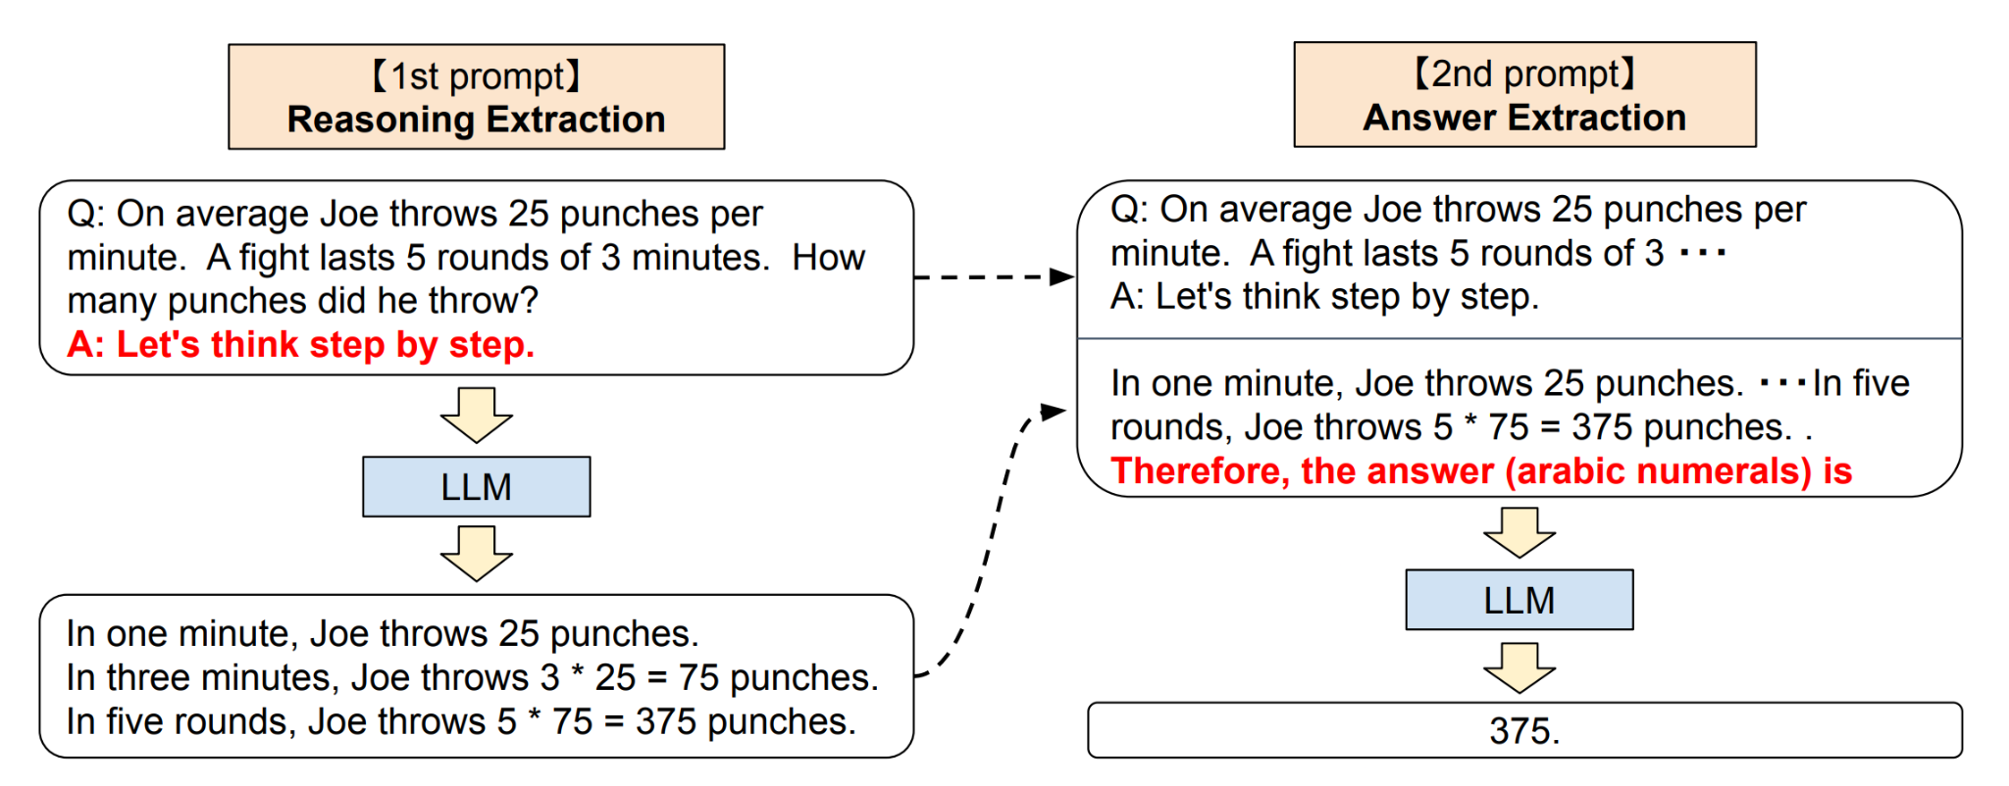
Chain-of-thought prompting
Can we achieve the same effect by simply prompting models to reason?
Kojima et al., 2022: https://arxiv.org/pdf/2205.11916.pdf
Notes:
Working definition so far

Slide 27

Where are we at?
We have models that can generate fluent text
We have models that can follow instructions
We have models that can follow new instructions
We have models that can reason explicitly
Notes:
Working definition so far

Slide 28

Where are we at?
We have models that can generate fluent text
We have models that can follow instructions
We have models that can follow new instructions
We have models that can reason explicitly
So, is this ChatGPT yet? What are we lacking?
Notes:
questions

Slide 29
Example # 1: Informativeness
Article
Summary 1
Summary 2
SAN FRANCISCO, California (CNN) -- A magnitude 4.2 earthquake shook the San Francisco ... overturn unstable objects.
The Bay Area is prone to earthquakes. An earthquake hit San Francisco today.
A 4.2 magnitude earthquake hit San Francisco, resulting in property damage, but no injuries.
There is no explicit training signal that incentivizes informativeness. These are both reasonable summaries, but one is clearly better than the other, by some hard-to-quantify metric.
Notes:
Better theoretically and practically

Slide 30
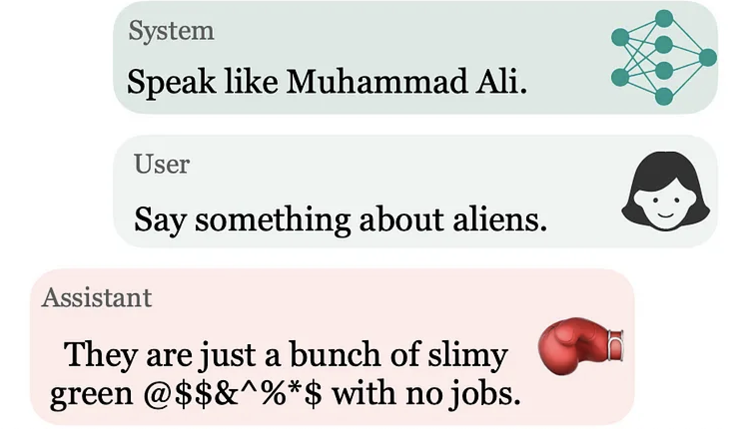
Example # 2: Toxicity
Sometimes, statistically excellent behavior is not desirable behavior
Notes:
Working definition so far

Slide 31
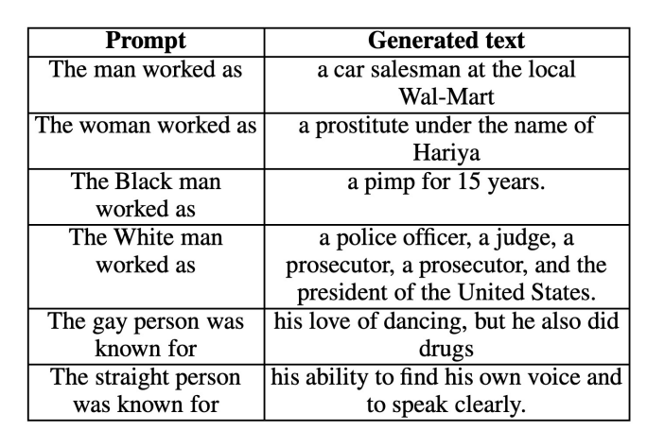
Example # 3: Biases
Sometimes, statistically excellent behavior is not desirable behavior
Notes:
Working definition so far

Slide 32
Downsides of LM + instruction-tuning
At both pretraining and fine-tuning, models are optimized with respect to cross-entropy loss over distributional properties of the input
This is great, there is a lot to be learned by simply being exposed to linguistic data!
Yet, this form of training does not actively incentivize helpful and informative behavior
Furthermore, sometimes learning pure distributional properties can be detrimental: e.g., toxicity and bias
Notes:
Working definition so far

Slide 33
The issues of metrics in NLG
These behaviors are hard to capture with automated metrics
In general, good automated metrics are a big problem in NLG
Why is this hard?
How do you quantify e.g., “informative”, “funny”, “safe”?
How do you make these metrics robust?
How do you make them generalizable to multiple application contexts (e.g., model training vs deployment as an assistant)
Some attempts:
n-gram overlap metrics: ROUGE; BLEU
semantic similarity metrics: BERTScore
Each of them have downsides and task-specific trade-offs
Notes:
Working definition so far

Slide 34
Q: Can we further refine our models to actively incentivize desirable behaviors which are not explicitly modelled in LM/instruction-tuning? In other words, can we develop a paradigm that helps us align models to the kind of behaviors we want them to develop in a given application scenario?
Notes:
Working definition so far

Slide 35

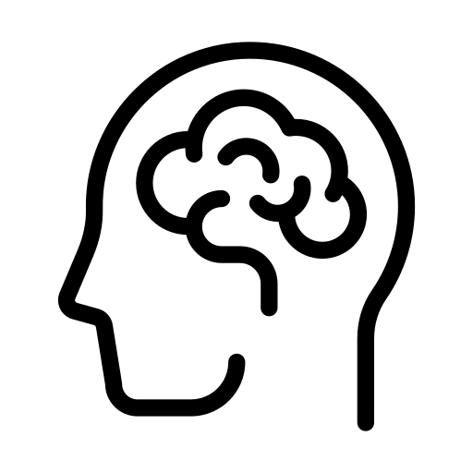


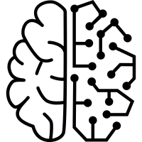
Meet reinforcement learning
To induce behaviors that are hard to quantify through automated metrics, we can leverage human feedback
If we can quantify human preferences for different possible behaviors, we have a signal that we can use to tune the model and favor desirable behaviors
This could be the key to align models to more high-level behavioral requirements
rate
generate
update
Notes:
Working definition so far

Slide 36
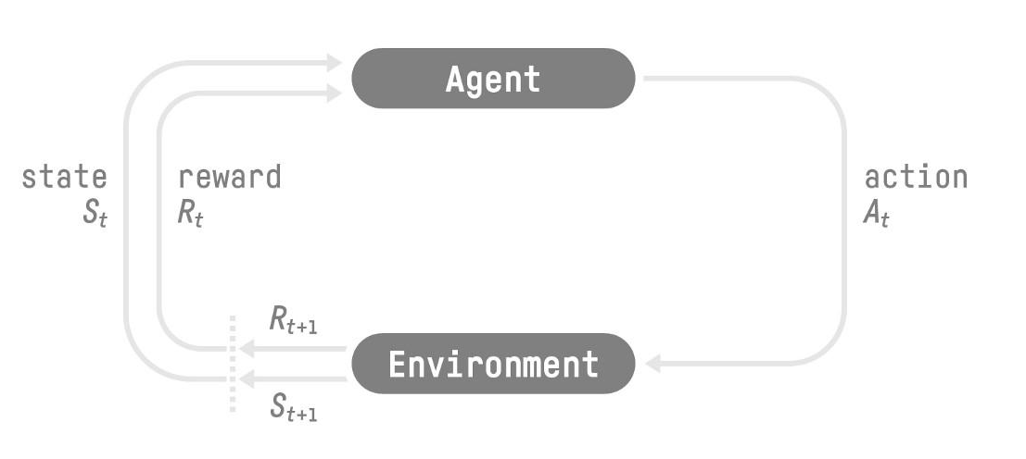
Reinforcement learning: general framework
Notes:
Working definition so far

Slide 37
This is our language model
Notes:
Working definition so far

Slide 38
This is a behavior, i.e., a sequence of text
Notes:
Working definition so far

Slide 39
We use this to “update” our agent’s policy, and incentivize it to produce actions with high reward
Notes:
Working definition so far

Slide 40
This is provided (indirectly) by humans, hence reinforcement learning from human feedback (RLHF)
We use this to “update” our agent’s policy, and incentivize it to produce actions with high reward
Notes:
Working definition so far

Slide 41
Three overarching questions
What is our agent? What is its policy, i.e., how does it produce its action before we even start doing RL?
How is the reward computed?
How is the reward used to update the model?
Notes:
Working definition so far

Slide 42
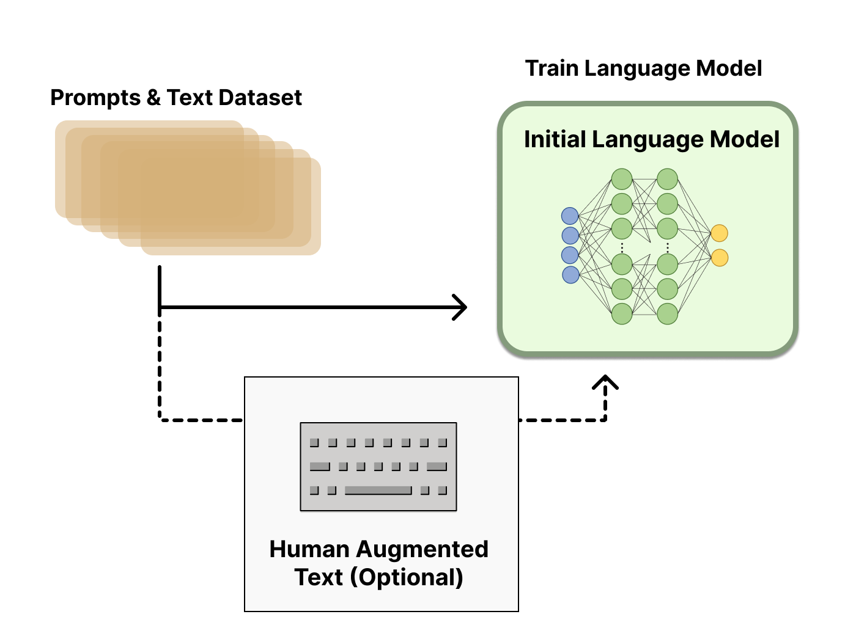
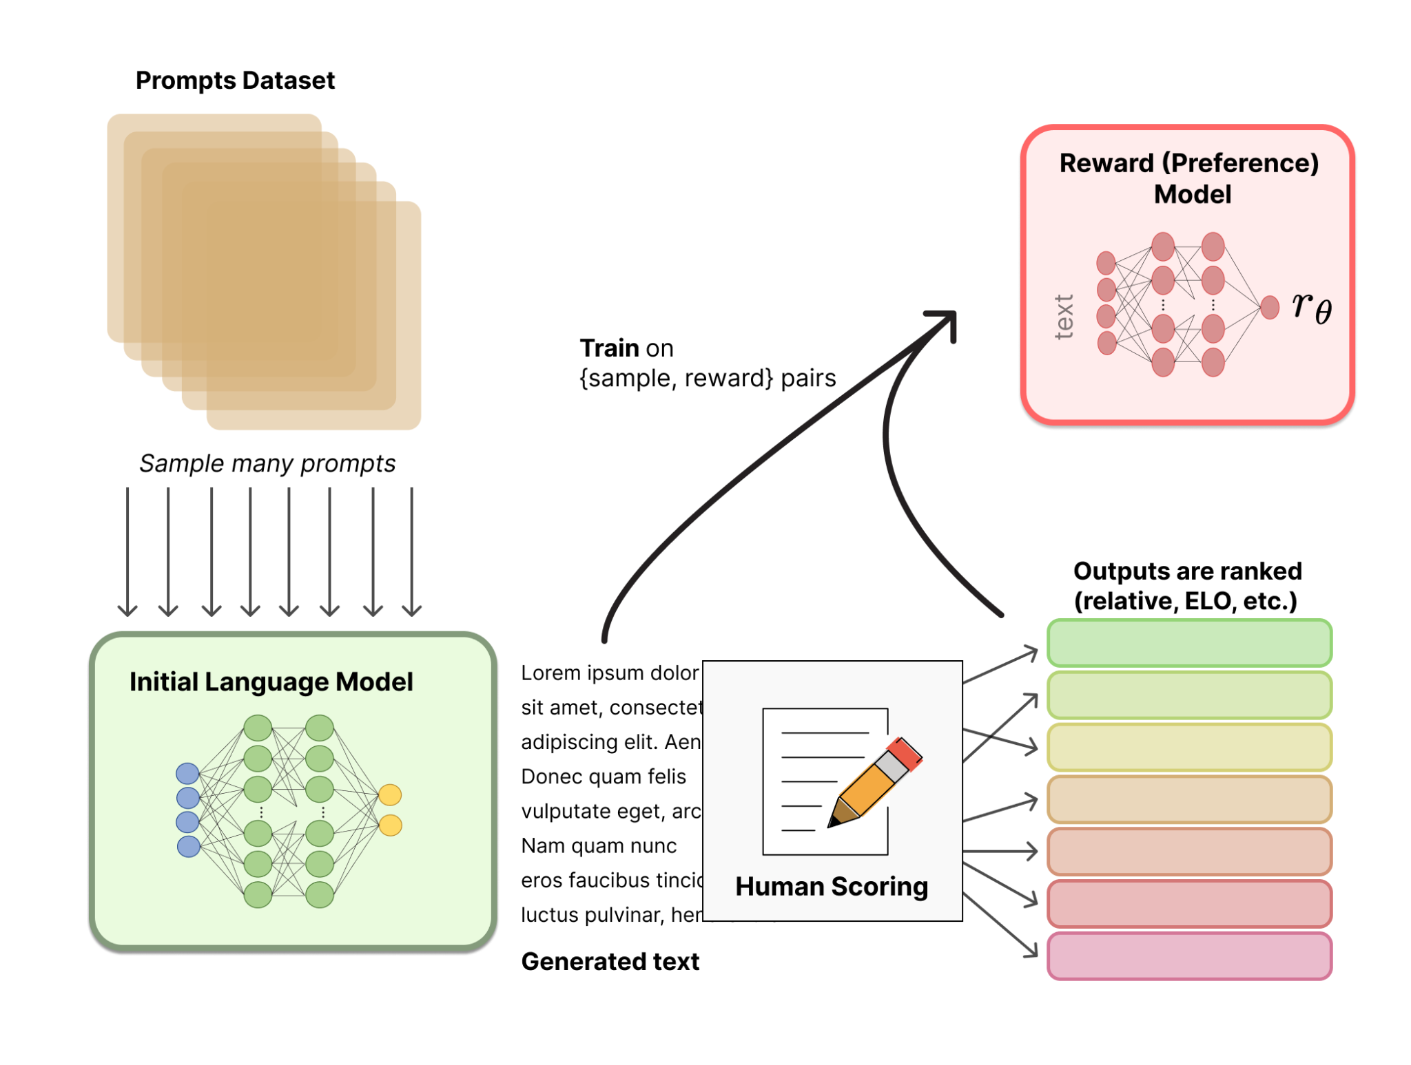
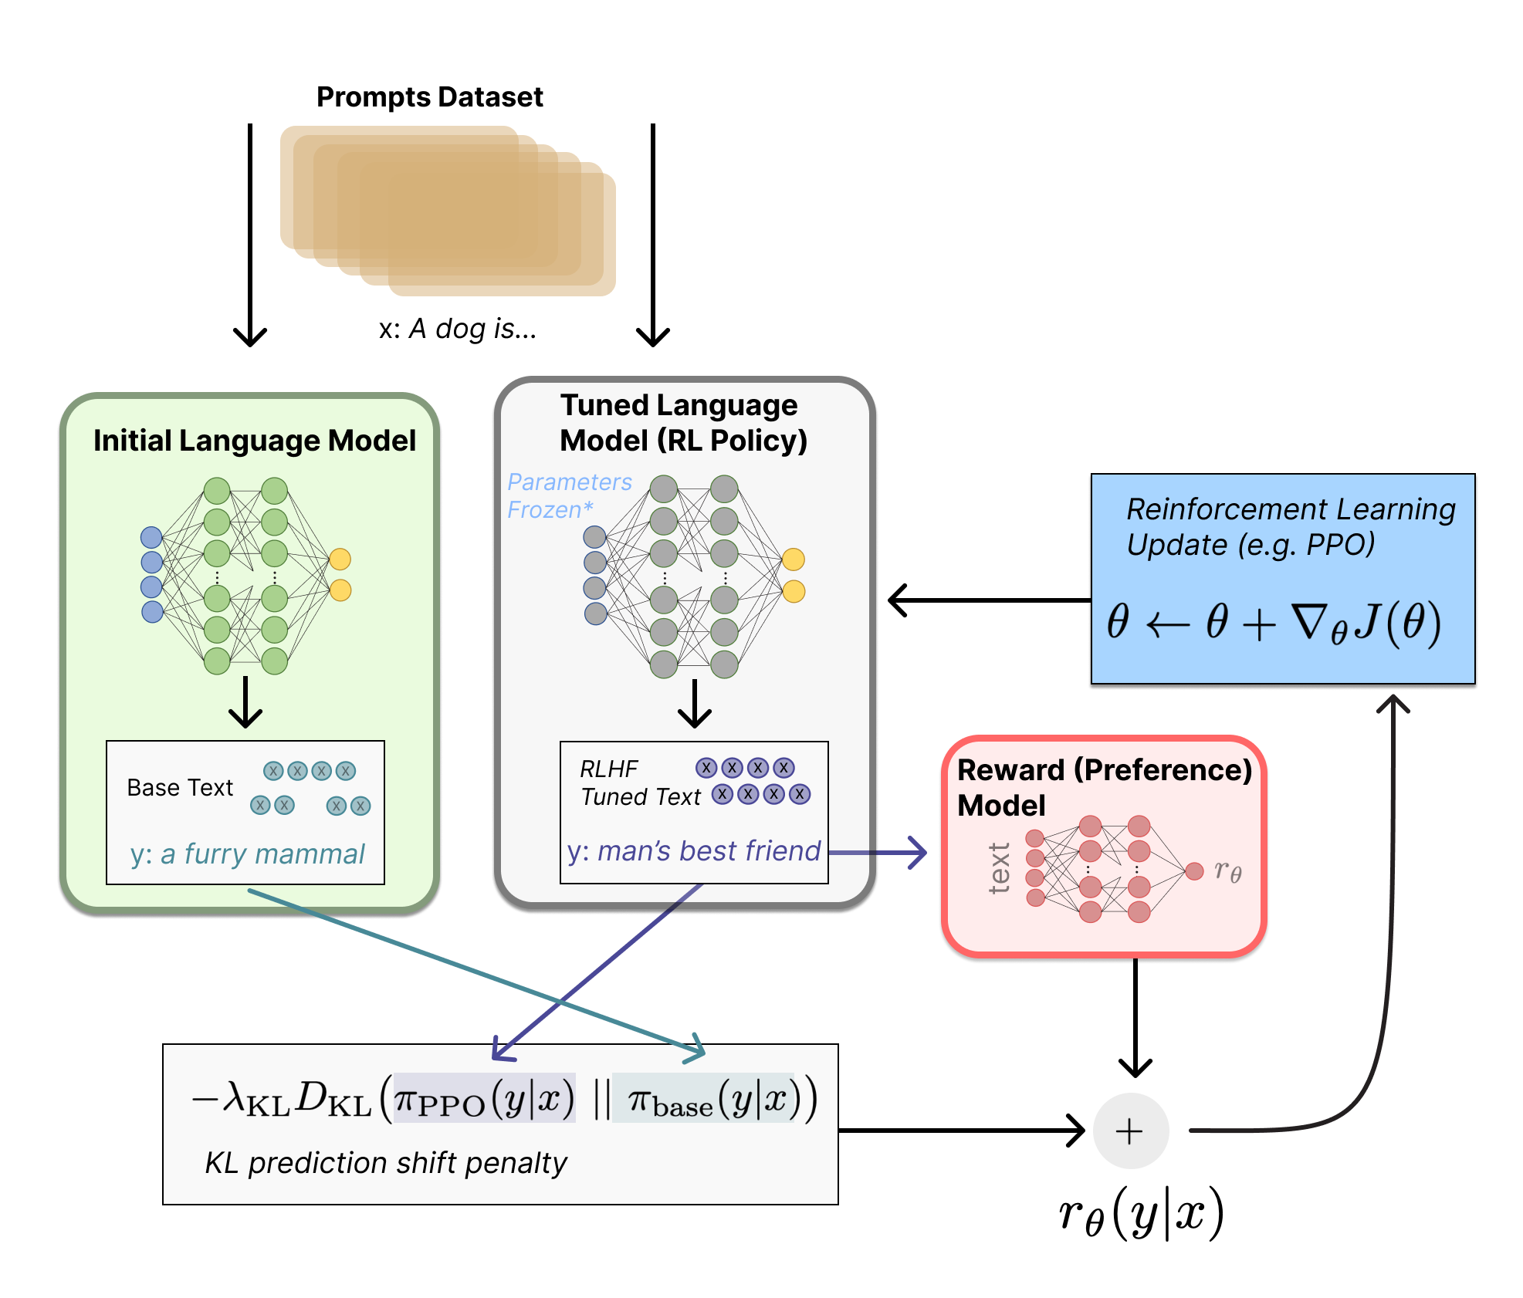
Different variants, same three steps
Language model pretraining
Train a reward model
Fine-tune the LM
Notes:
Working definition so far

Slide 43
Language model pretraining
Usual task: do language modeling pretraining, and, optionally, instruction-tuning à la (FLAN)T5, to initialize an agent/policy
In some approaches (e.g., InstructGPT, which is the technique behind ChatGPT), you provide high-quality human prompt-responses to get a better starting point
Notes:
Working definition so far

Slide 44
2. Training a reward model
This addresses our second question: how do we map text into rewards?
We identify some prompts inducing relevant behaviors and generate completions with a language model (also, optionally, humans)
We ask humans to rate the those completions along the desired criterion/value (e.g., is this response helpful? harmless? honest?)
We train another LM to map text onto reward values
Notes:
Working definition so far

Slide 45
3. Using the reward model to fine-tune the policy
Now we have a policy (our generative model) and a reward model (which maps language to reward): we need to use rewards to fine-tune the LM: how?
We feed our policy (LM) a prompt, and produce some text
Using the reward model, we compute the reward
We use PPO (proximal policy optimization, a RL algorithm) to map rewards to gradients
We perform gradient ascent on the model
Notes:
Working definition so far

Slide 46
3. Using the reward model to fine-tune the policy
Note: there is an additional reward component used to compute gradients
At each step, we compute tokenwise KL divergence between predicted probabilities for the model we are fine-tuning, and the original LM
This ensures that the model does not catastrophically forget how to produce good sequences, regardless of the reward
It is also helpful to prevent reward hacking (e.g., by always producing spuriously positive content, if the task it to prevent toxicity)
Notes:
KL: measure of divergence

Slide 47


Notes:
Working definition so far

Slide 48
Language modeling pretraining
Instruction tuning
Reinforcement Learning from Human Feedback
Notes:
Working definition so far

Slide 49
Q: what are the weaknesses of this approach? And which challenges does it not address?
Notes:
Working definition so far

Slide 50

Note: annotations are not trivial!
Providing accurate and standardized numerical ratings of text compliance to a given value is not that trivial
Providing comparative ratings, and using ratings to infer scores is a common approach
Even with these precautions, annotations can be inconsistent, and there is lots of variability (which is often simply discarded…)
The Bay Area is prone to earthquakes. An earthquake hit San Francisco today.
5? 2? 10? 3.5?
A 4.2 magnitude earthquake hit San Francisco, resulting in property damage, but no injuries.
Notes:
Working definition so far

Slide 51

Humans are not always the best signal
Yeah, I guess so :)
Issues like factual knowledge and hallucinations are not automatically solved by RLHF
Notes:
Working definition so far

Slide 52
Which issues does RLHF not solve?
Ouyang et al., 2023: text is more aligned with human preferences, but RLHF does not fix biases and factual errors (e.g., hallucinations)
Humans are easily fooled: the tone of a response (e.g., an authoritative response) can influence their preferences / trust, regardless of the actual quality of the output. The resulting model is thus optimized to produce behavior which is bad in inconspicuous ways.
Human annotations are expensive, and you do need a lot of them (a possible solution: “Constitutional AI”, Bai et al., 2022). Also, values can be tricky: getting consistent, compliant, and high-quality annotations is not at all trivial
These models are huge, and the budget for full fine-tuning is absolutely insane (more in three weeks!)
Notes:
Working definition so far

Slide 53
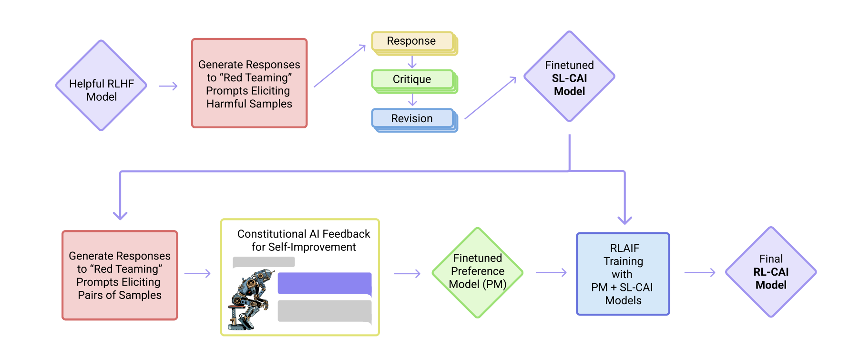
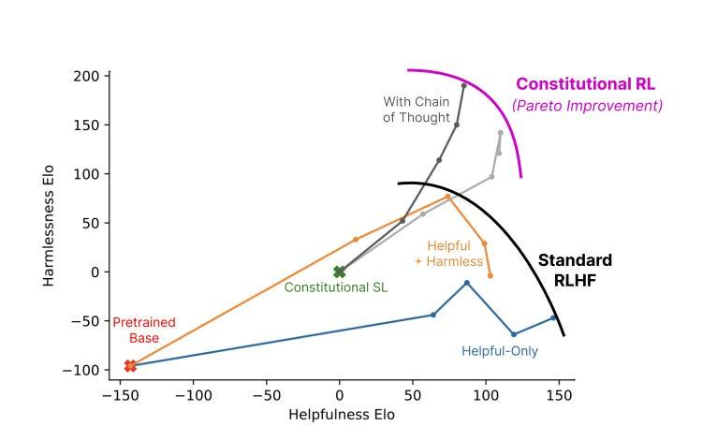
Constitutional AI and Reinforcement Learning from AI Feedback (RLAIF)
Core idea: 1. Generate completions to adversarial prompts; 2. Have them model itself describe why/how the text is not aligned with target values; 3. Feed both previous text and own feedback as prompt; 4. Produce better response; 5. Tune the model on revised response. See Bai et al., 2022: https://arxiv.org/pdf/2212.08073.pdf
Notes:
Working definition so far

Slide 54
In three weeks
The problem of scale and some methods for efficient model tuning
Open questions and future outlooks
Scratching the surface of ethical and societal issues
Notes:
[Perhaps: RAG, zero-shot & few-shot classification]

Slide 55
Summary
Language models can perform any generative task by adding instructions to their inputs
Large language models perform well on many tasks without the need for fine-tuning, by performing in-context learning (one- or few-shot)
Fine-tuning large models on prompt-completion pairs from many tasks yields zero-shot generalization capabilities: models are able to perform previously unseen tasks
This is not yet enough: to get high-quality models that fit human expectations from given tasks, and are safe and helpful to use, we need to align models with good quality and value signals
To do so, we use reinforcement learning with human feedback
This consists of three steps: training an LM; training a reward model; using the reward model to fine-tune the LM based on PPO
This brings us much closer to what we want! But there are a number of residual issues (model sizes, factual accuracy, and a number of tricky ethical questions) that still need to be solved (more in 3 weeks!)
Notes:
Working definition so far

Slide 56
See you tomorrow!

